Slide 1
15-780 – Graduate Artificial Intelligence:
Supervised learning: basics
Aditi Raghunathan
Carnegie Mellon University
Spring 2023

Slide 2
Outline
What is machine learning?
Linear regression
Linear classification
Nonlinear methods

Slide 3
Outline
What is machine learning?
Linear regression
Linear classification
Nonlinear methods

Slide 4
What is learning?
An agent is learning if it improves performance after making observations about the world
Machine learning: When a computer learns from data

Slide 5
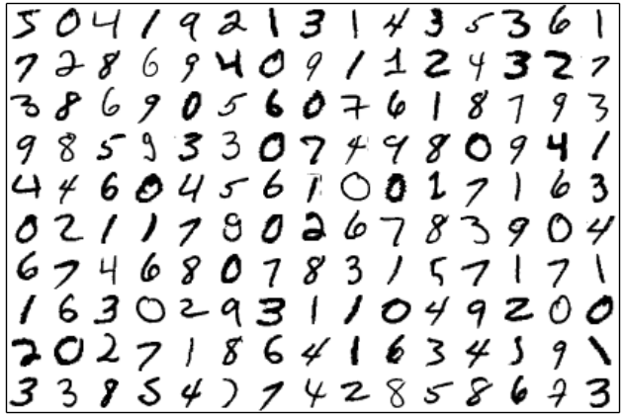
Why machine learning?
The task: write a program that, given a 28x28 grayscale image of a digit, outputs the number in the image
Image: digits from the MNIST data set (http://yann.lecun.com/exdb/mnist/)

Slide 6


Approaches
Approach 1: try to write a program by hand that uses your a priori knowledge about what images look like to determine what number they are
Approach 2: (the machine learning approach) collect a large volume of images and their corresponding numbers, let the “write its own program” to map from these images to their corresponding number
8
5

Slide 7
Types of learning
Supervised learning: learn from (input, output) pairs
Unsupervised learning: Detecting patterns from inputs alone (for e.g. clustering)
Reinforcement learning: Learn from a series of rewards and punishments

Slide 8


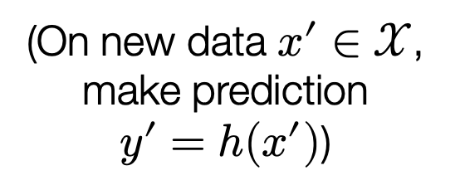
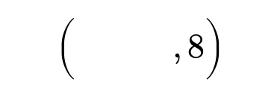

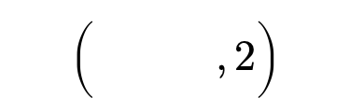
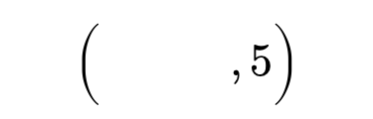

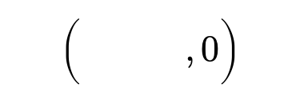
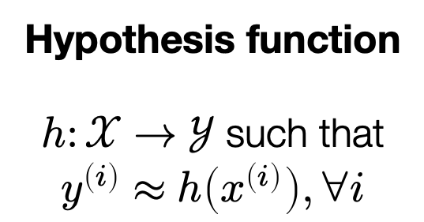
Supervised learning pipeline
Training data
$$\left(\begin{matrix} & \\ & \end{matrix},2\right)$$
$$\left(\begin{matrix} & \\ & \end{matrix},0\right)$$
Hypothesis function
$h:𝒳→𝒴$ such that
$$y^{\left(i\right)}≈h\left(x^{\left(i\right)}\right), ∀i$$
Machine learning algorithm
$$\left(\begin{matrix} & \\ & \end{matrix},5\right)$$
$$\left(\begin{matrix} & \\ & \end{matrix},8\right)$$
(On new data $x^{′}∈𝒳$, make prediction
$y^{′}=h(x^{′})$)
$$y^{\left(i\right)}∈𝒴$$
$$x^{\left(i\right)}∈𝒳$$

Slide 9
Outline
What is machine learning?
Linear regression
Linear classification
Nonlinear methods
Overfitting, generalization, and regularization
Evaluating machine learning algorithms

Slide 10
A little history
[1801] Astronomer Piazzi discovered Ceres and made 19 observations of its location
When and where will Ceres be observed again?
Assuming only Kepler’ three laws, and method of least squares, Gauss predicted the position within half-degree error
Notes:
When Gauss first discovered this at 18 years of age, he considered the least squares method to be quite obvious to any mathematician and relatively inconsequential. First published by Legendre in 1805.
Pointed to a completely new region in space

Slide 11
A simple example: predicting electricity use
What will peak power consumption be in Pittsburgh tomorrow?
Difficult to build an “a priori” model from first principles to answer this question
But, relatively easy to record past days of consumption, plus additional features that affect consumption (i.e., weather)
Date | High Temperature (F) | Peak Demand (GW)
2011-06-01 | 84.0 | 2.651
2011-06-02 | 73.0 | 2.081
2011-06-03 | 75.2 | 1.844
2011-06-04 | 84.9 | 1.959
… | … | …

Slide 12
Plot of consumption vs. temperature
Plot of high temperature vs. peak demand for summer months (June – August) for past six years

Slide 13
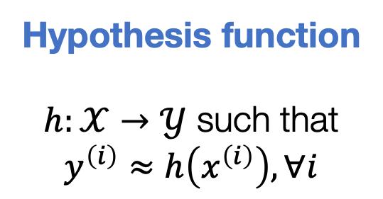
Supervised learning pipeline
Training data
$$\left(\begin{matrix} & \\ & \end{matrix},2\right)$$
$$\left(\begin{matrix} & \\ & \end{matrix},0\right)$$
Hypothesis function
$h:𝒳→𝒴$ such that
$$y^{\left(i\right)}≈h\left(x^{\left(i\right)}\right), ∀i$$
Machine learning algorithm
$$\left(\begin{matrix} & \\ & \end{matrix},5\right)$$
$$\left(\begin{matrix} & \\ & \end{matrix},8\right)$$
(On new data $x^{′}∈𝒳$, make prediction
$y^{′}=h(x^{′})$)
$$y^{\left(i\right)}∈𝒴$$
$$x^{\left(i\right)}∈𝒳$$

Slide 14
Predictions
Predicting in this manner is equivalent to “drawing line through data”

Slide 15
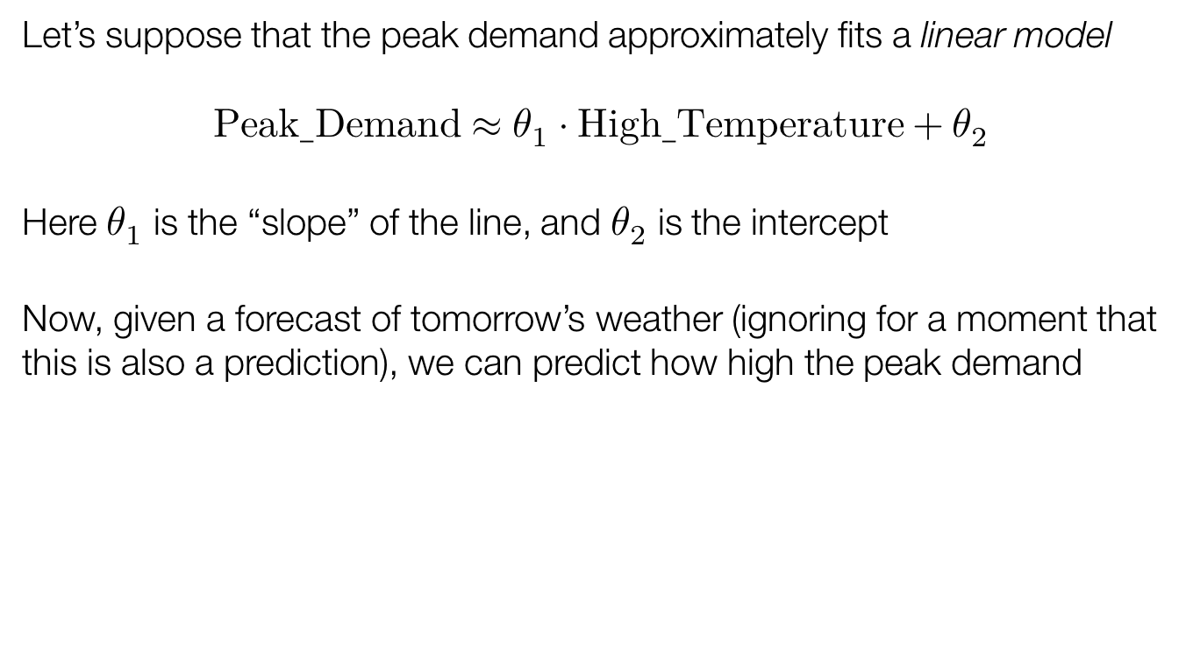
Hypothesis: linear model
Let’s suppose that the peak demand approximately fits a linear model
$$Peak_Demand≈θ_{1}⋅High_Temperature+θ_{2}$$
Here $θ_{1}$ is the “slope” of the line, and $θ_{2}$ is the intercept
Now, given a forecast of tomorrow’s weather (ignoring for a moment that this is also a prediction), we can predict how high the peak demand

Slide 16
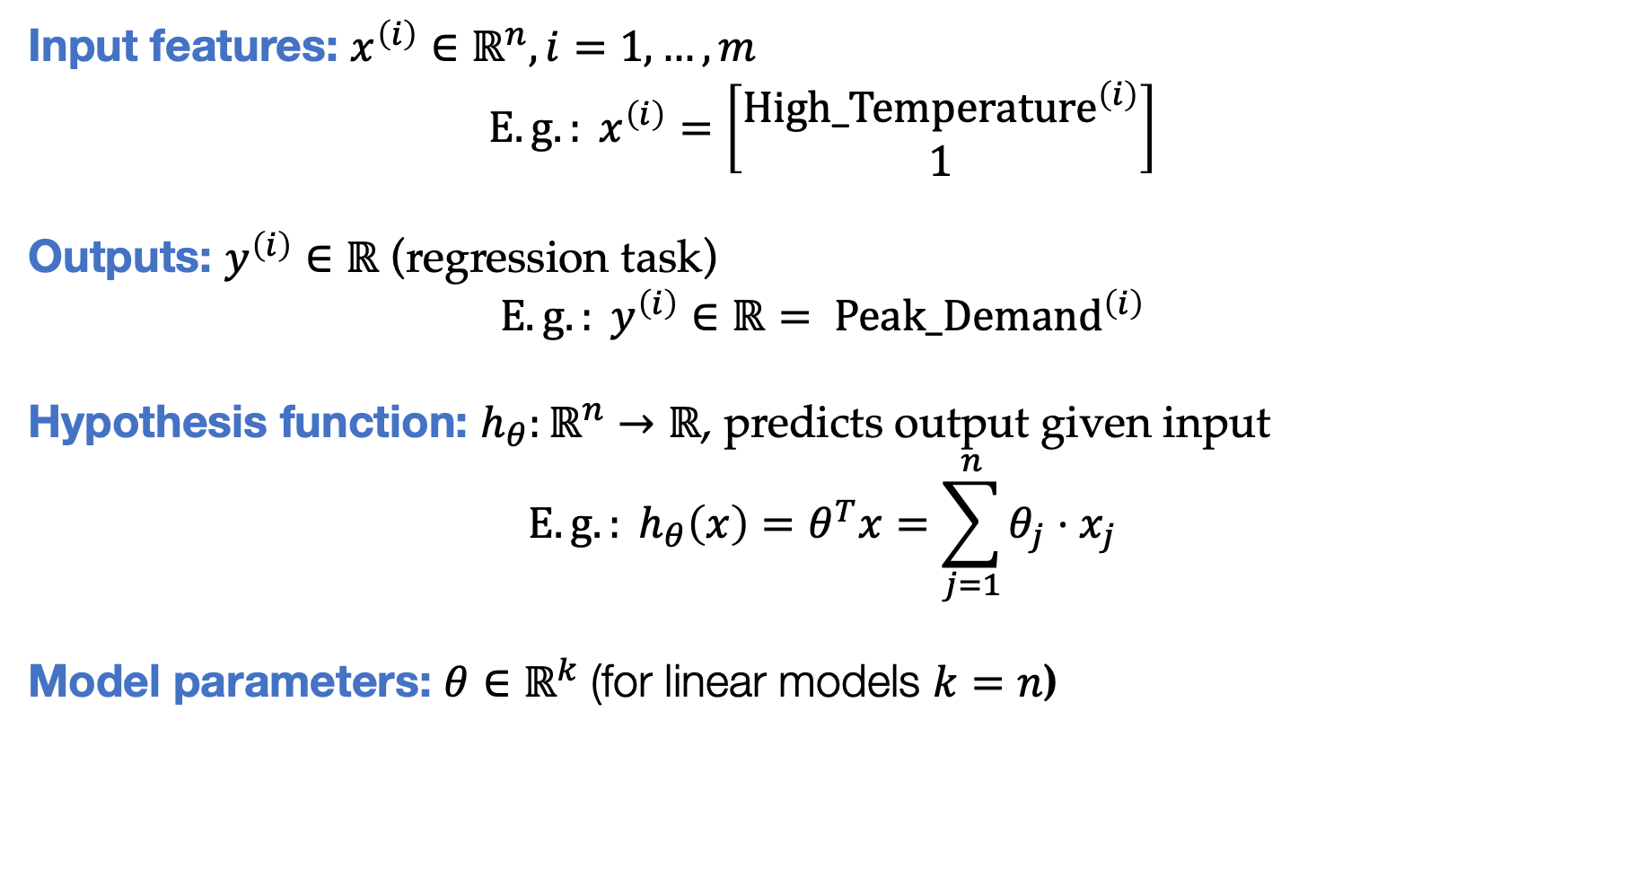
Machine learning notation
Input features: $x^{\left(i\right)}∈ℝ^{n}, i=1,…,m$
$$E.g.: x^{\left(i\right)}=\left[\begin{matrix}High_{Temperature}^{\left(i\right)} \\ 1\end{matrix}\right]$$
Outputs: $y^{\left(i\right)}∈ℝ$ (regression task)
$${E.g.: y}^{\left(i\right)}∈ℝ= Peak_{Demand}^{\left(i\right)}$$
Hypothesis function: $h_{θ}:ℝ^{n}→ℝ$, predicts output given input
$$E.g.: h_{θ}\left(x\right)=θ^{T}x=\sum_{j=1}^{n}{θ_{j}}{⋅x}_{j}$$
Model parameters: $θ∈ℝ^{k}$ (for linear models $k=n$)
Training data

Slide 17
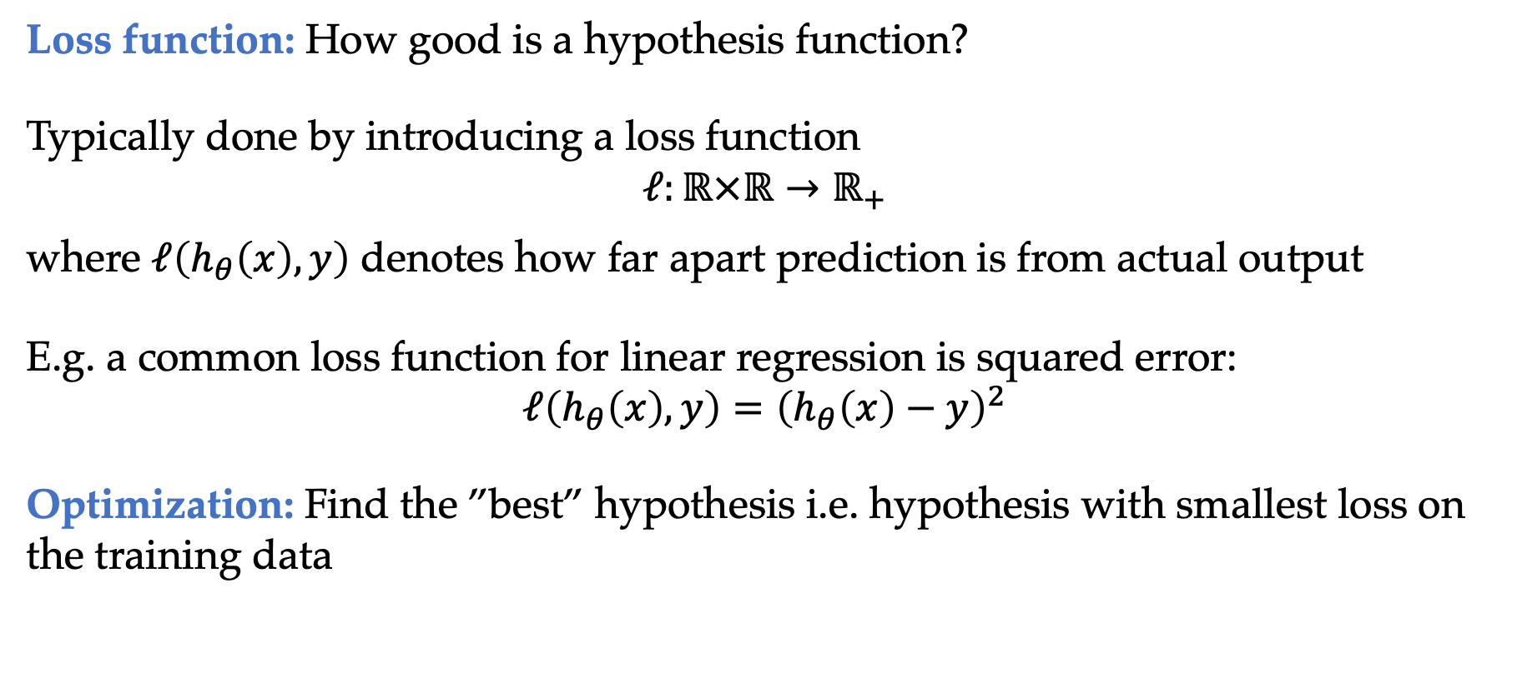
How to obtain best hypothesis?
Loss function: How good is a hypothesis function?
Typically done by introducing a loss function
$$ℓ:ℝ×ℝ→ℝ_{+}$$
where $ℓ\left(h_{θ}\left(x\right),y\right)$ denotes how far apart prediction is from actual output
E.g. a common loss function for linear regression is squared error:
$$ℓ\left(h_{θ}\left(x\right),y\right)={\left(h_{θ}\left(x\right)−y\right)}^{2}$$
Optimization: Find the ”best” hypothesis i.e. hypothesis with smallest loss on the training data

Slide 18
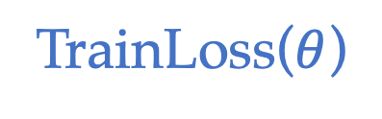
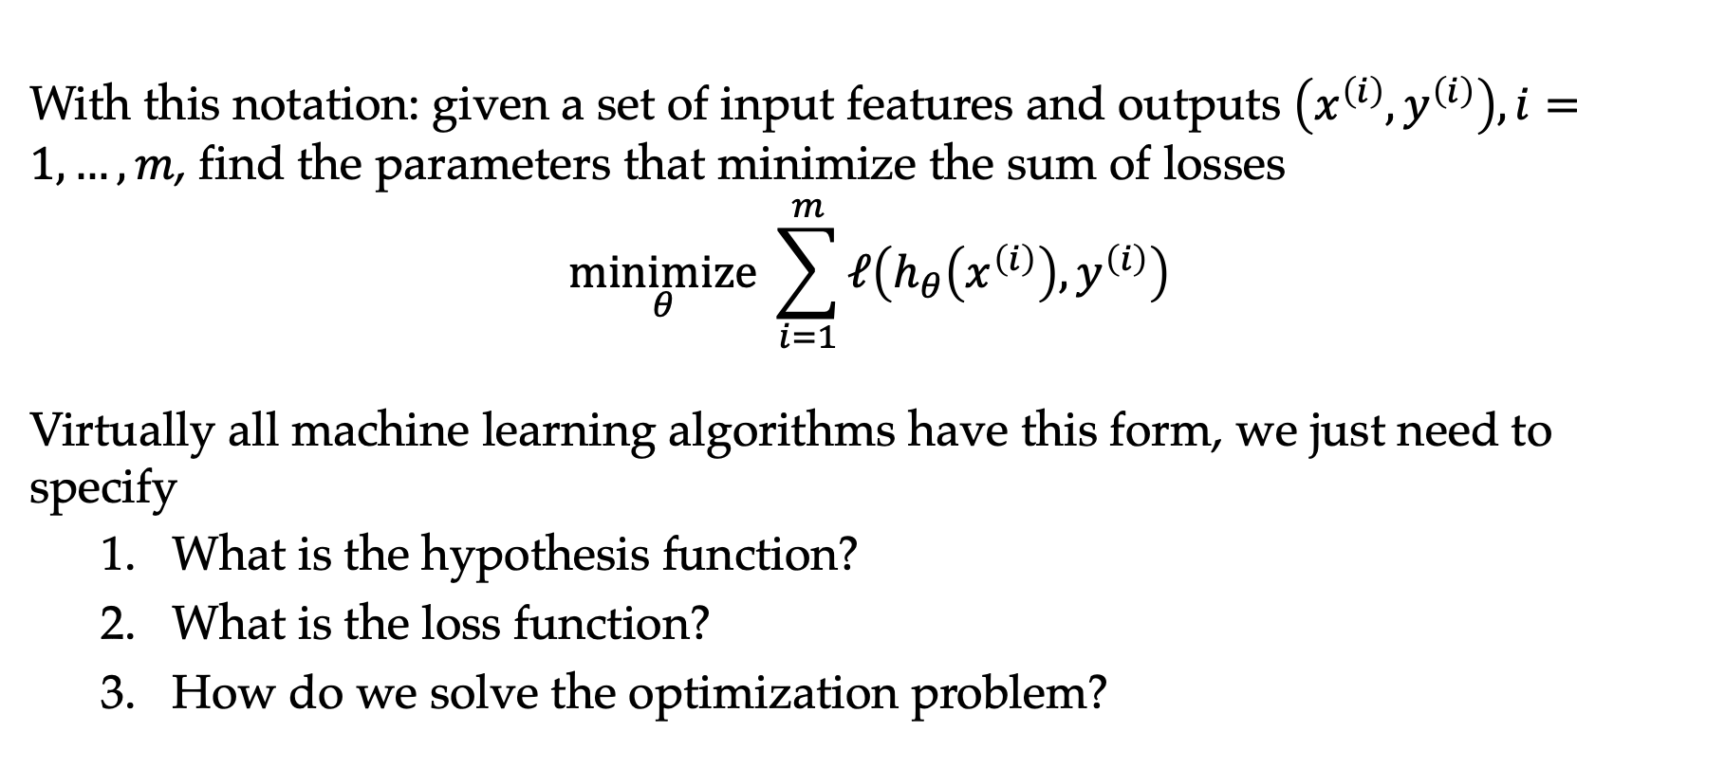
The canonical machine learning problem
With this notation: given a set of input features and outputs $\left(x^{\left(i\right)},y^{\left(i\right)}\right), i=1,…,m$, find the parameters that minimize the sum of losses
$$\underset{θ}{minimize}{ \sum_{i=1}^{m}{ℓ\left(h_{θ}\left(x^{\left(i\right)}\right),y^{\left(i\right)}\right)}}$$
Virtually all machine learning algorithms have this form, we just need to specify
  What is the hypothesis function?
  What is the loss function?
  How do we solve the optimization problem?
TrainLoss($θ$)

Slide 19
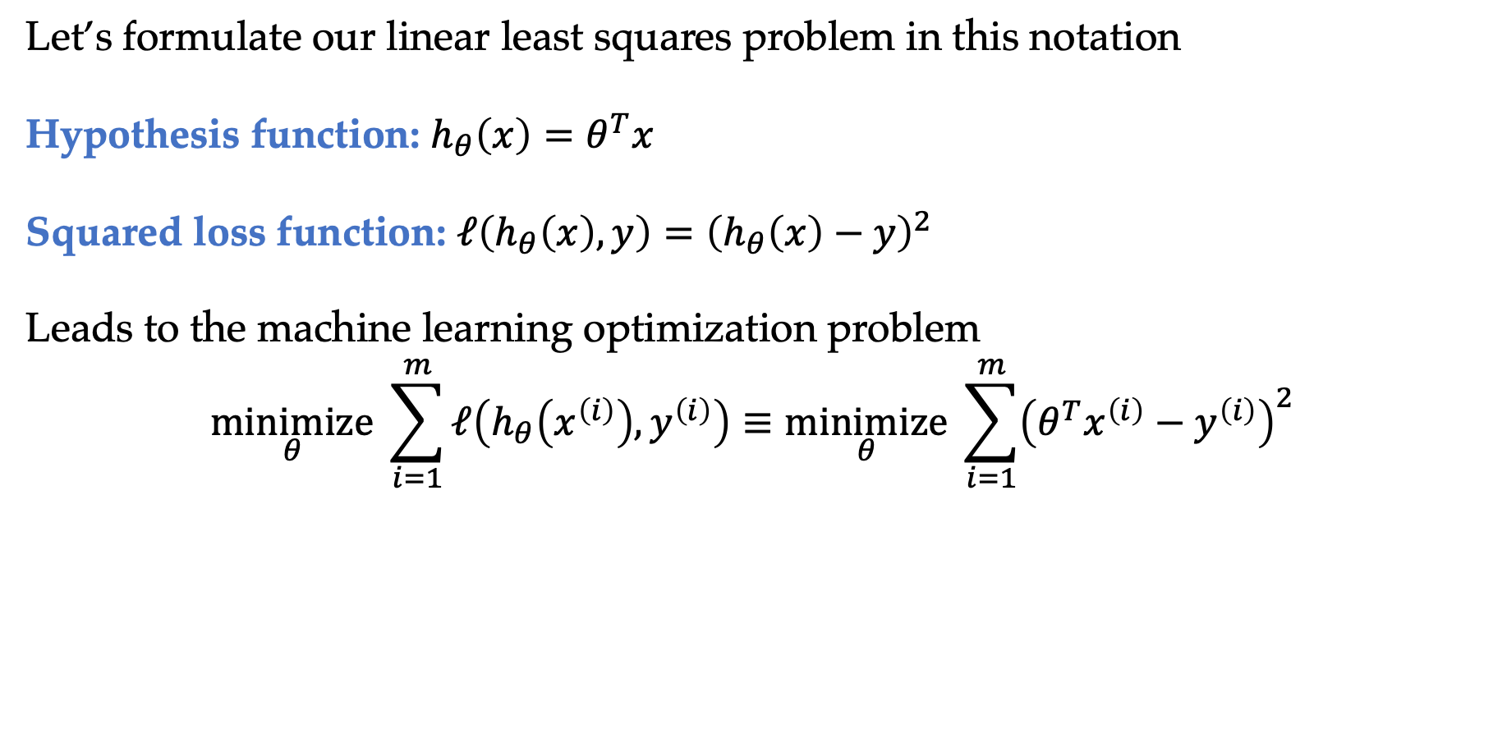
Least squares
Let’s formulate our linear least squares problem in this notation
Hypothesis function: $h_{θ}\left(x\right)=θ^{T}x$
Squared loss function: $ℓ\left(h_{θ}\left(x\right),y\right)={\left(h_{θ}\left(x\right)−y\right)}^{2}$
Leads to the machine learning optimization problem
$$\underset{θ}{minimize}{ \sum_{i=1}^{m}{ℓ\left(h_{θ}\left(x^{\left(i\right)}\right),y^{\left(i\right)}\right)}}≡\underset{θ}{minimize}{ \sum_{i=1}^{m}{{\left(θ^{T}x^{\left(i\right)}−y^{\left(i\right)}\right)}^{2}}}$$
Is this convex?

Slide 20
Least squares
Let’s formulate our linear least squares problem in this notation
Hypothesis function: $h_{θ}\left(x\right)=θ^{T}x$
Squared loss function: $ℓ\left(h_{θ}\left(x\right),y\right)={\left(h_{θ}\left(x\right)−y\right)}^{2}$
Leads to the machine learning optimization problem
$$\underset{θ}{minimize}{ \sum_{i=1}^{m}{ℓ\left(h_{θ}\left(x^{\left(i\right)}\right),y^{\left(i\right)}\right)}}≡\underset{θ}{minimize}{ \sum_{i=1}^{m}{{\left(θ^{T}x^{\left(i\right)}−y^{\left(i\right)}\right)}^{2}}}$$
Is this convex?

Slide 21
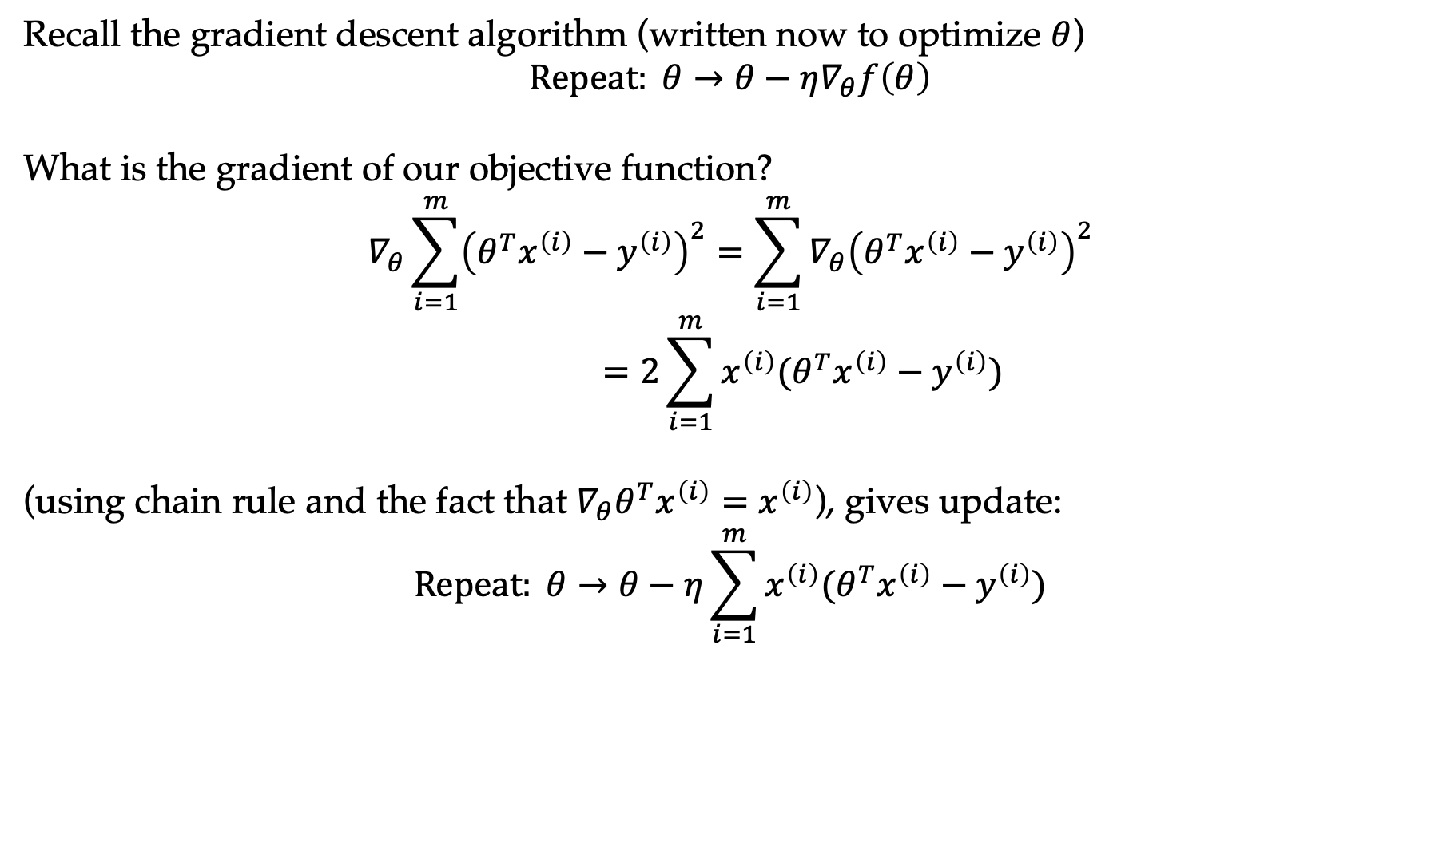
Solution via gradient descent
Recall the gradient descent algorithm (written now to optimize $θ$)
$$Repeat: θ→θ−η∇_{θ}f\left(θ\right)$$
What is the gradient of our objective function?
$$∇_{θ}\sum_{i=1}^{m}{{\left(θ^{T}x^{\left(i\right)}−y^{\left(i\right)}\right)}^{2}}=\sum_{i=1}^{m}{{∇_{θ}\left(θ^{T}x^{\left(i\right)}−y^{\left(i\right)}\right)}^{2}} \\ =2\sum_{i=1}^{m}{x^{\left(i\right)}(θ^{T}x^{\left(i\right)}−y^{\left(i\right)})}$$
(using chain rule and the fact that $∇_{θ}θ^{T}x^{\left(i\right)}=x^{\left(i\right)}$), gives update:
$$Repeat: θ→θ−η\sum_{i=1}^{m}{x^{\left(i\right)}(θ^{T}x^{\left(i\right)}−y^{\left(i\right)})}$$

Slide 22
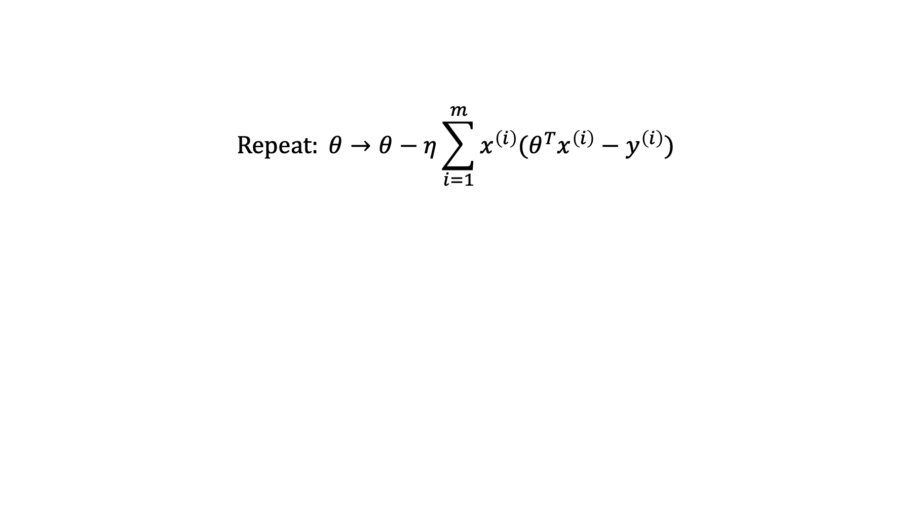
Solution via gradient descent
$$Repeat: θ→θ−η\sum_{i=1}^{m}{x^{\left(i\right)}(θ^{T}x^{\left(i\right)}−y^{\left(i\right)})}$$
Residual

Slide 23
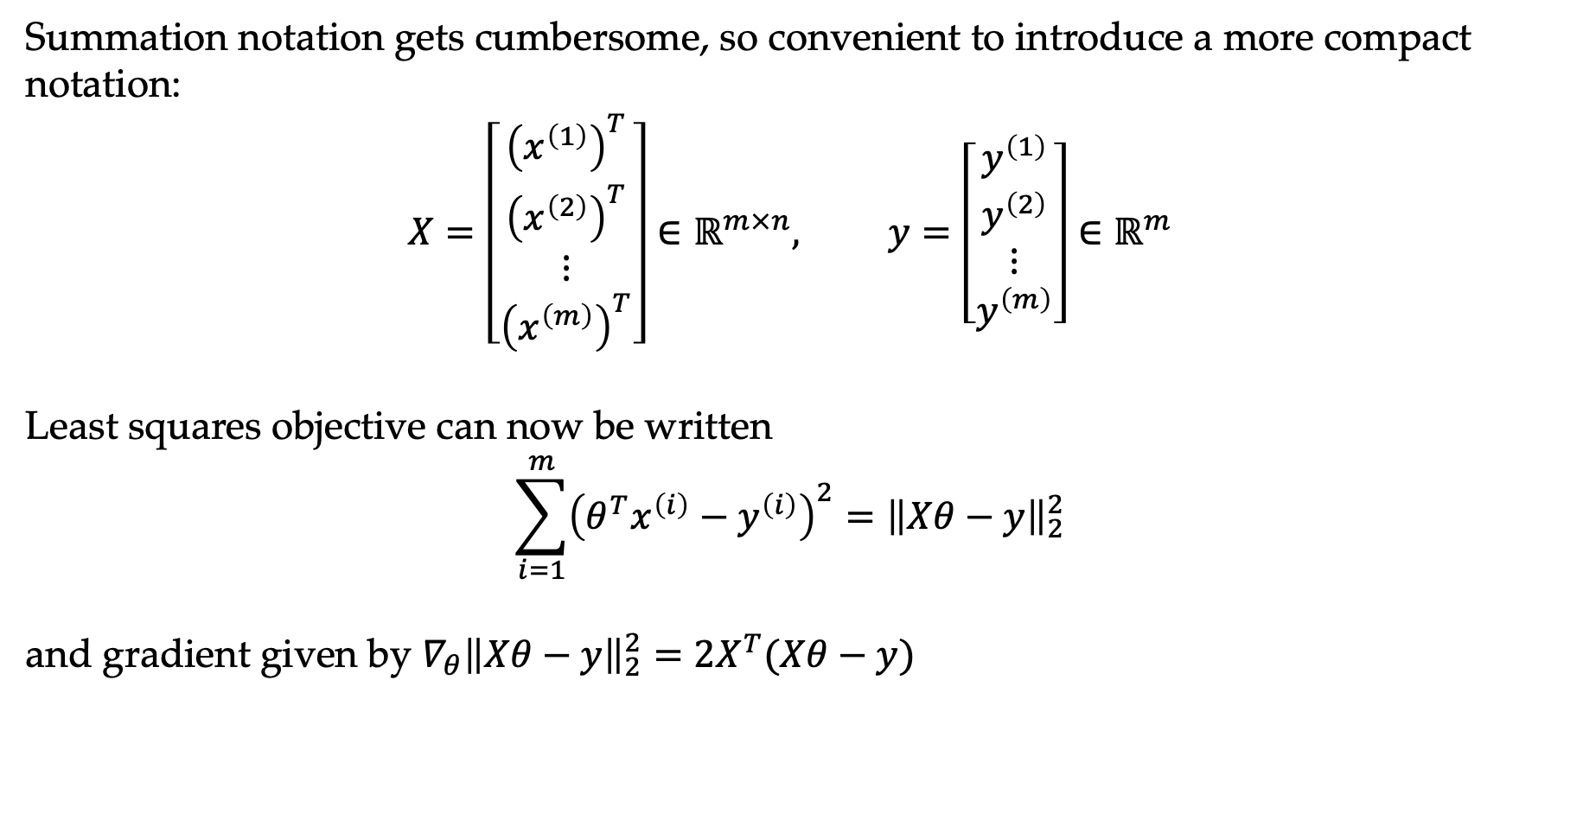
Linear algebra notation
Summation notation gets cumbersome, so convenient to introduce a more compact notation:
$$X=\left[\begin{matrix}{\left(x^{\left(1\right)}\right)}^{T} \\ {\left(x^{\left(2\right)}\right)}^{T} \\ ⋮ \\ {\left(x^{\left(m\right)}\right)}^{T}\end{matrix}\right]∈ℝ^{m×n}, y=\left[\begin{matrix}y^{\left(1\right)} \\ y^{\left(2\right)} \\ ⋮ \\ y^{\left(m\right)}\end{matrix}\right]∈ℝ^{m}$$
Least squares objective can now be written
$$\sum_{i=1}^{m}{{\left(θ^{T}x^{\left(i\right)}−y^{\left(i\right)}\right)}^{2}}={\left\|Xθ−y\right\|}_{2}^{2}$$
and gradient given by $∇_{θ}{\left\|Xθ−y\right\|}_{2}^{2}=2X^{T}(Xθ−y)$

Slide 24
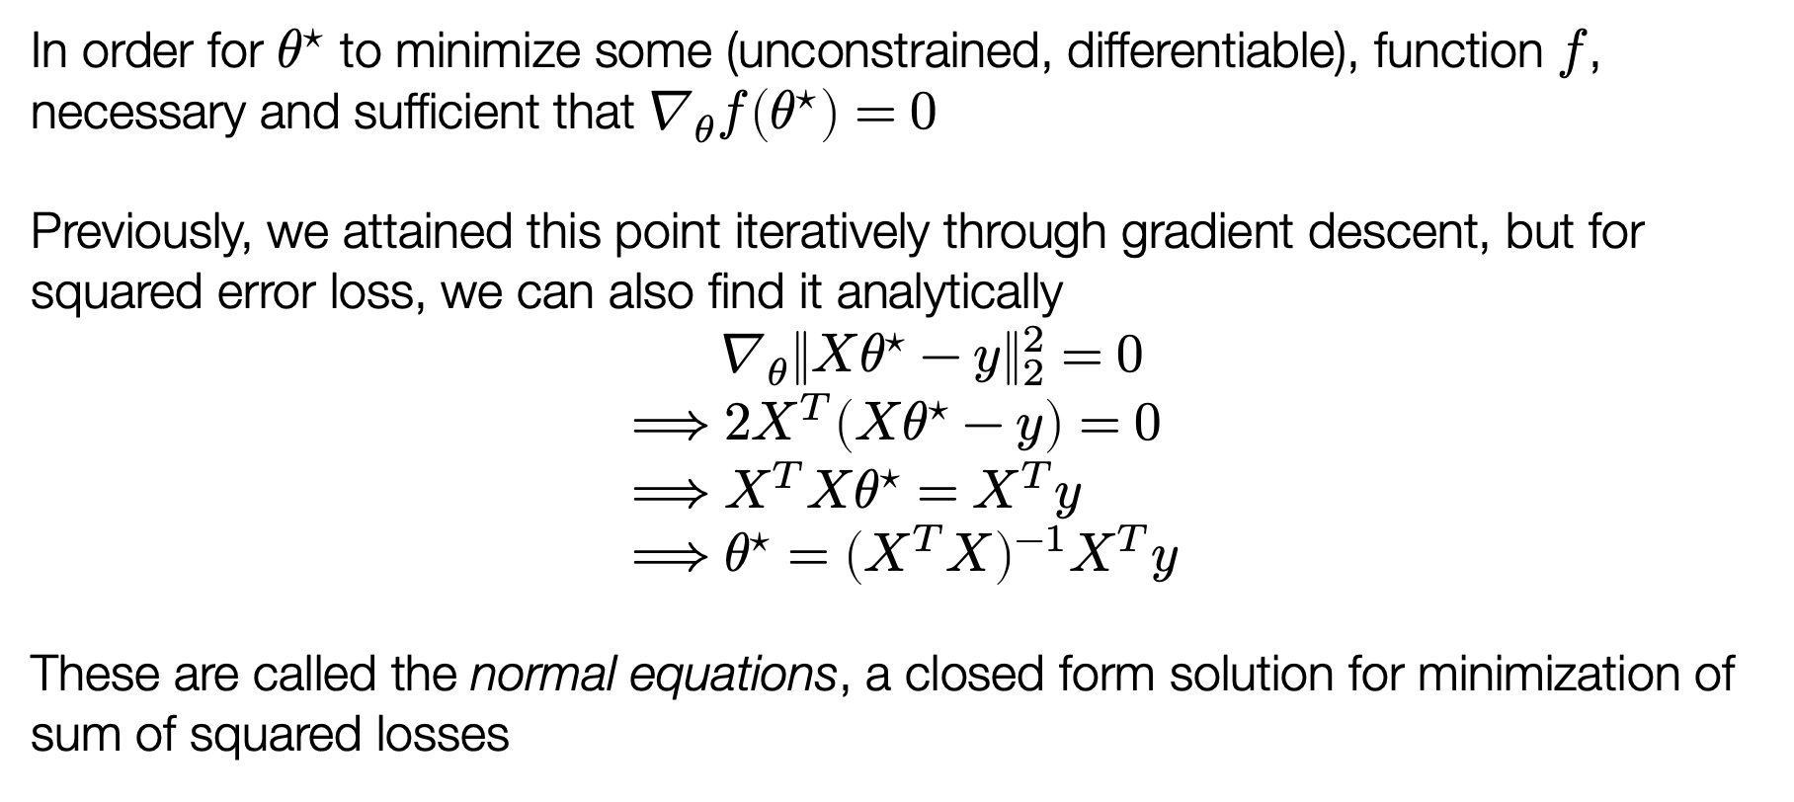
An alternative solution method
In order for $θ^{⋆}$ to minimize some (unconstrained, differentiable), function $f$, necessary and sufficient that $∇_{θ}f\left(θ^{⋆}\right)=0$
Previously, we attained this point iteratively through gradient descent, but for squared error loss, we can also find it analytically
$${ ∇}_{θ}{\left\|Xθ^{⋆}−y\right\|}_{2}^{2}=0 \\ ⟹2X^{T}\left(Xθ^{⋆}−y\right)=0 \\ ⟹X^{T}Xθ^{⋆}=X^{T}y \\ ⟹θ^{⋆}={\left(X^{T}X\right)}^{−1}X^{T}y$$
These are called the normal equations, a closed form solution for minimization of sum of squared losses

Slide 25
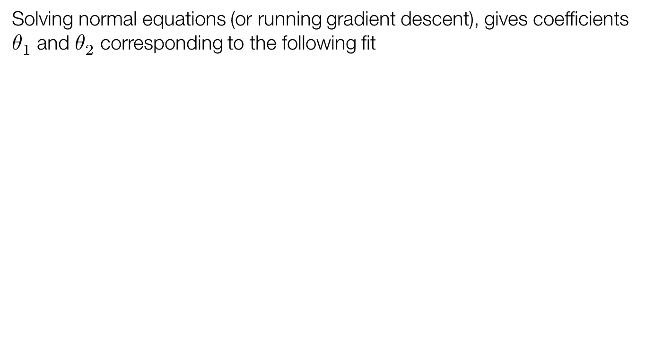
Least squares solution
Solving normal equations (or running gradient descent), gives coefficients $θ_{1}$ and $θ_{2}$ corresponding to the following fit

Slide 26
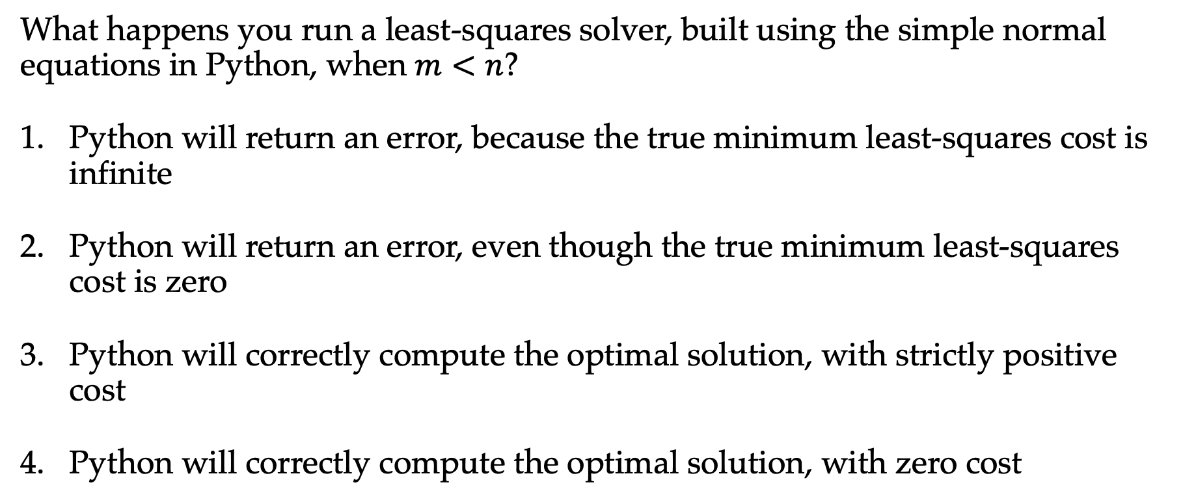

Question: least squares when $m < n$
What happens you run a least-squares solver, built using the simple normal equations in Python, when $m<n$?
Python will return an error, because the true minimum least-squares cost is infinite
Python will return an error, even though the true minimum least-squares cost is zero
Python will correctly compute the optimal solution, with strictly positive cost
Python will correctly compute the optimal solution, with zero cost

Slide 27
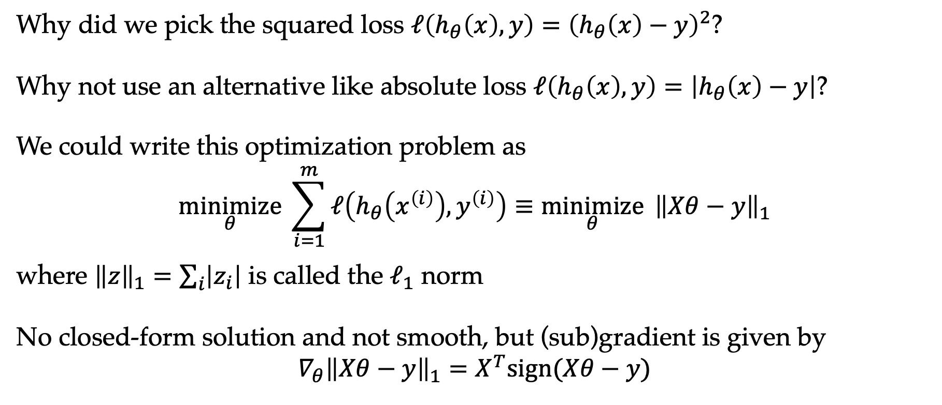
Alternative loss functions
Why did we pick the squared loss $ℓ\left(h_{θ}\left(x\right),y\right)={\left(h_{θ}\left(x\right)−y\right)}^{2}$?
Why not use an alternative like absolute loss $ℓ\left(h_{θ}\left(x\right),y\right)=\left|h_{θ}\left(x\right)−y\right|$?
We could write this optimization problem as
$$\underset{θ}{minimize}{ \sum_{i=1}^{m}{ℓ\left(h_{θ}\left(x^{\left(i\right)}\right),y^{\left(i\right)}\right)}}≡\underset{θ}{minimize}{ {\left\|Xθ−y\right\|}_{1}}$$
where ${\left\|z\right\|}_{1}=\sum_{i}{\left|z_{i}\right|}$ is called the $ℓ_{1}$ norm
No closed-form solution and not smooth, but (sub)gradient is given by
$$∇_{θ}{\left\|Xθ−y\right\|}_{1}=X^{T}sign(Xθ−y)$$

Slide 28
Q: alternative loss solutions
Solutions for minimizing squared error and absolute error
Poll: which solution is which?
Green is squared loss, red is absolute
Red is squared loss, green is absolute
Those lines look identical to me

Slide 29
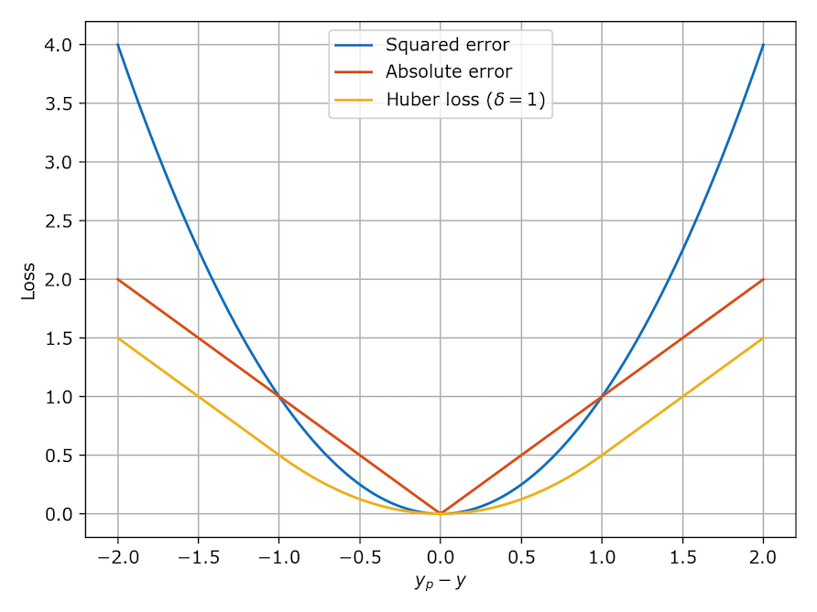
Alternative loss functions

Slide 30
Q: which loss to use
Suppose data has a lot of outliers, should you use the squared loss or the huber loss?

Slide 31
Outline
What is machine learning?
Linear regression
Linear classification
Nonlinear methods

Slide 32
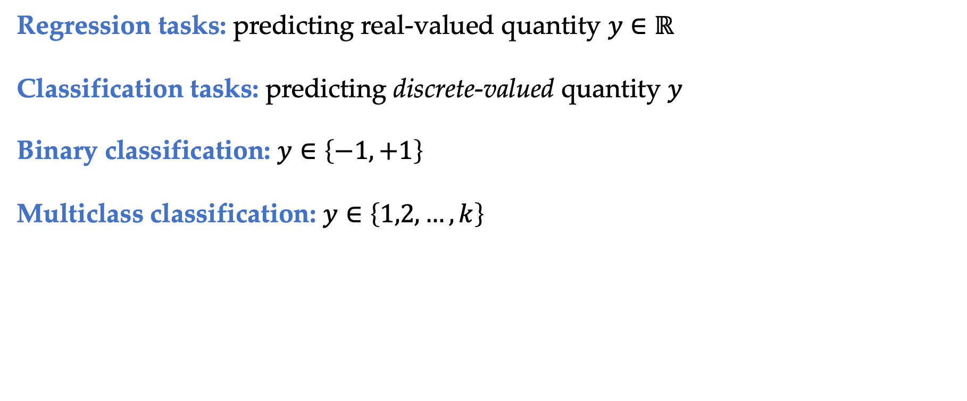
Classification tasks
Regression tasks: predicting real-valued quantity $y∈ℝ$
Classification tasks: predicting discrete-valued quantity $y$
Binary classification: $y∈\left\{−1,+1\right\}$
Multiclass classification: $y∈\left\{1,2,…,k\right\}$

Slide 33
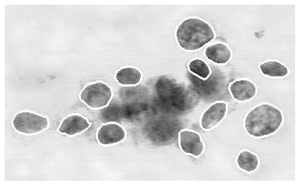
Example: breast cancer classification
Well-known classification example: using machine learning to diagnose whether a breast tumor is benign or malignant [Street et al., 1992]
Setting: doctor extracts a sample of fluid from tumor, stains cells, then outlines several of the cells (image processing refines outline)
System computes features for each cell such as area, perimeter, concavity, texture (10 total); computes mean/std/max for all features
Notes:
We will talk more about feature engineering in the class

Slide 34
Example: breast cancer classification
Plot of two features: mean area vs. mean concave points, for two classes

Slide 35
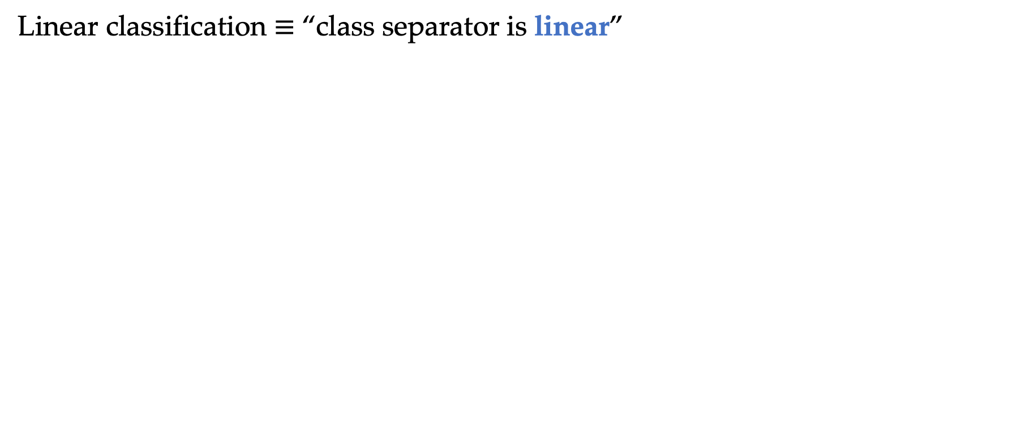
Linear classification example
Linear classification $≡$ “class separator is linear”

Slide 36
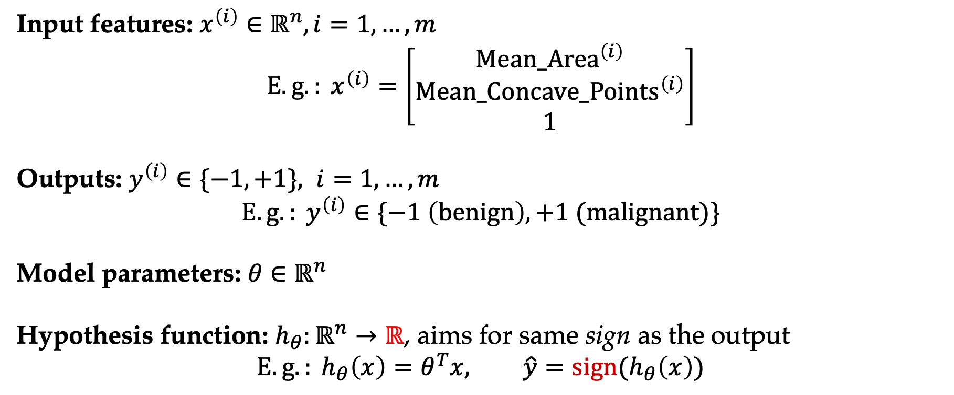
Formal setting
Input features: $x^{\left(i\right)}∈ℝ^{n}, i=1,…,m$
$$E.g.: x^{\left(i\right)}=\left[\begin{matrix}Mean_{Area}^{\left(i\right)} \\ Mean_Concave_{Points}^{\left(i\right)} \\ 1\end{matrix}\right]$$
Outputs: $y^{\left(i\right)}∈\{−1,+1\}, i=1,…,m$
$${E.g.: y}^{\left(i\right)}∈\{−1 \left(benign\right), +1 (malignant)\}$$
Model parameters: $θ∈ℝ^{n}$
Hypothesis function: $h_{θ}:ℝ^{n}→ℝ$, aims for same sign as the output
$$E.g.: h_{θ}\left(x\right)=θ^{T}x, \hat{y}=sign(h_{θ}\left(x\right))$$

Slide 37
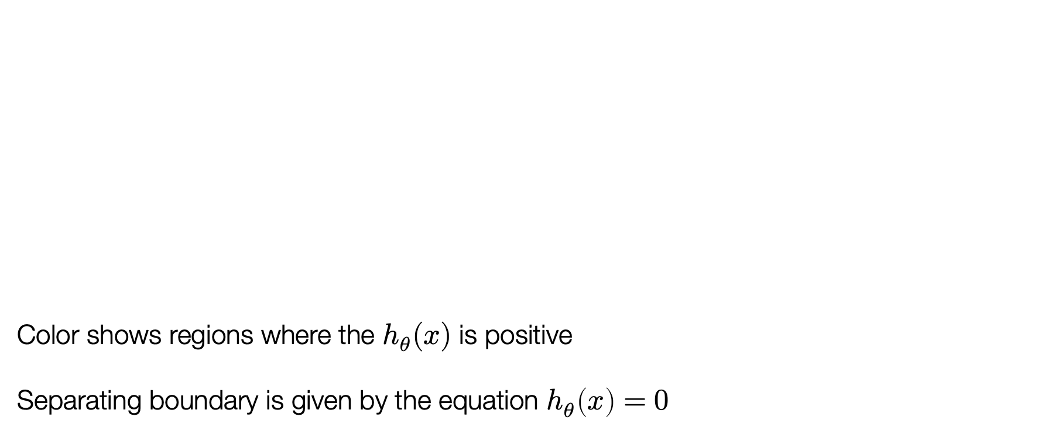

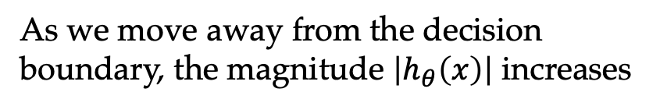
Understanding linear classification diagrams
Color shows regions where the $h_{θ}(x)$ is positive
Separating boundary is given by the equation $h_{θ}\left(x\right)=0$
As we move away from the decision boundary, the magnitude $\left|h_{θ}\left(x\right)\right|$ increases
The output $h_{θ}\left(x\right)=θ^{T}x$ measures the “confidence” of the model on input

Slide 38
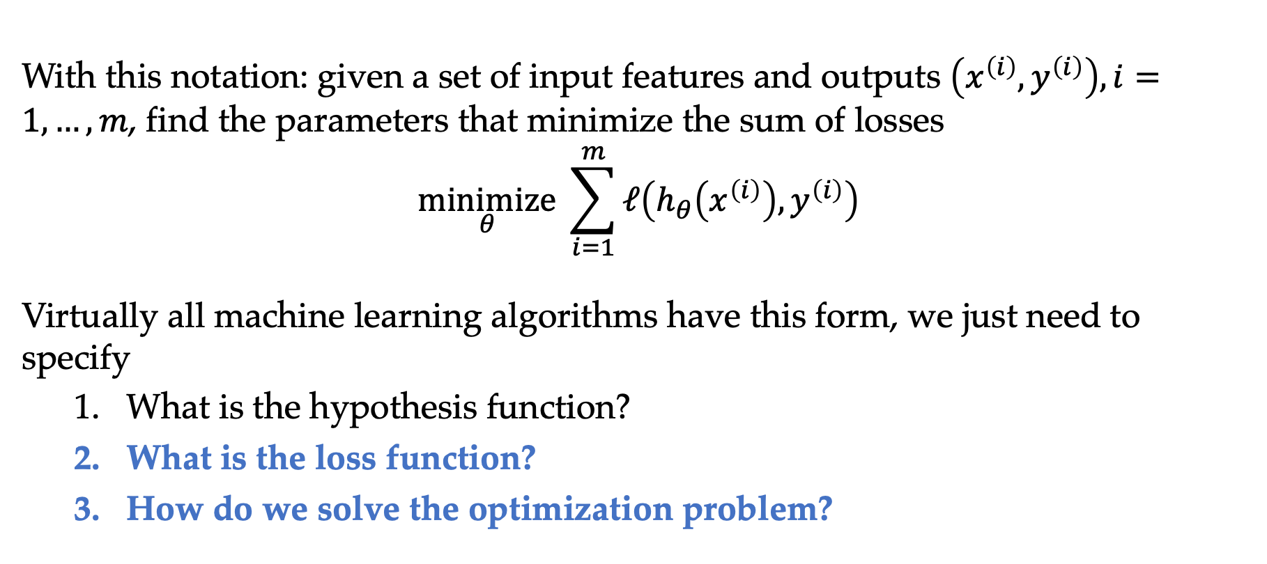
The canonical machine learning problem
With this notation: given a set of input features and outputs $\left(x^{\left(i\right)},y^{\left(i\right)}\right), i=1,…,m$, find the parameters that minimize the sum of losses
$$\underset{θ}{minimize}{ \sum_{i=1}^{m}{ℓ\left(h_{θ}\left(x^{\left(i\right)}\right),y^{\left(i\right)}\right)}}$$
Virtually all machine learning algorithms have this form, we just need to specify
  What is the hypothesis function?
  What is the loss function?
  How do we solve the optimization problem?
TrainLoss($θ$)

Slide 39
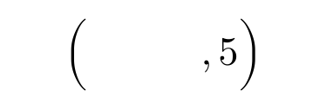
Loss functions for classification
How do we define a loss function $ℓ:ℝ×\{−1,+1\}→ℝ_{+}$?
What about just using squared loss?
Least squares tries to make every point equally confident

Slide 40

0/1 loss (i.e. error)
The loss we would like to minimize (0/1 loss, or just “error”):
$$ℓ_{0/1}\left(h_{θ}\left(x\right), y\right)= \left\{\begin{matrix}0 & if sign\left(h_{θ}\left(x\right)\right)=y \\ 1 & otherwise\end{matrix}\right. \\ =1\{y⋅h_{θ}\left(x\right)≤0\}$$
Is there an issue with this loss?

Slide 41
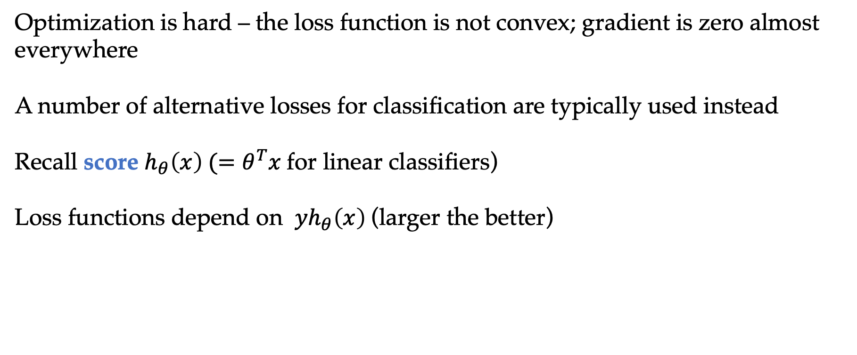
Alternative losses
Optimization is hard – the loss function is not convex; gradient is zero almost everywhere
A number of alternative losses for classification are typically used instead
Recall score $h_{θ}\left(x\right) (=θ^{T}x$for linear classifiers)
Loss functions depend on ${yh}_{θ}\left(x\right)$(larger the better)

Slide 42
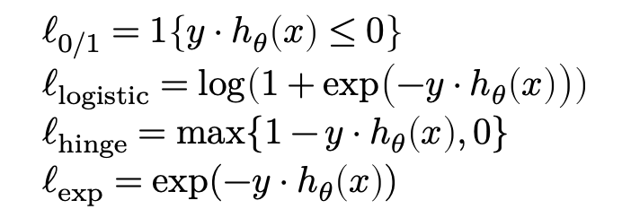
Alternative losses
Optimization is hard – the loss function is not convex; gradient is zero almost everywhere
A number of alternative losses for classification are typically used instead
$$ℓ_{0/1}=1\left\{y⋅h_{θ}\left(x\right)≤0\right\} \\ ℓ_{logistic}=\log\left(1+\exp\left(−y⋅h_{θ}\left(x\right)\right)\right) \\ ℓ_{hinge}=\max{\{1−}y⋅h_{θ}\left(x\right), 0\} \\ ℓ_{exp}=exp⁡(−y⋅h_{θ}\left(x\right))$$
More confident and wrong
More confident and right

Slide 43
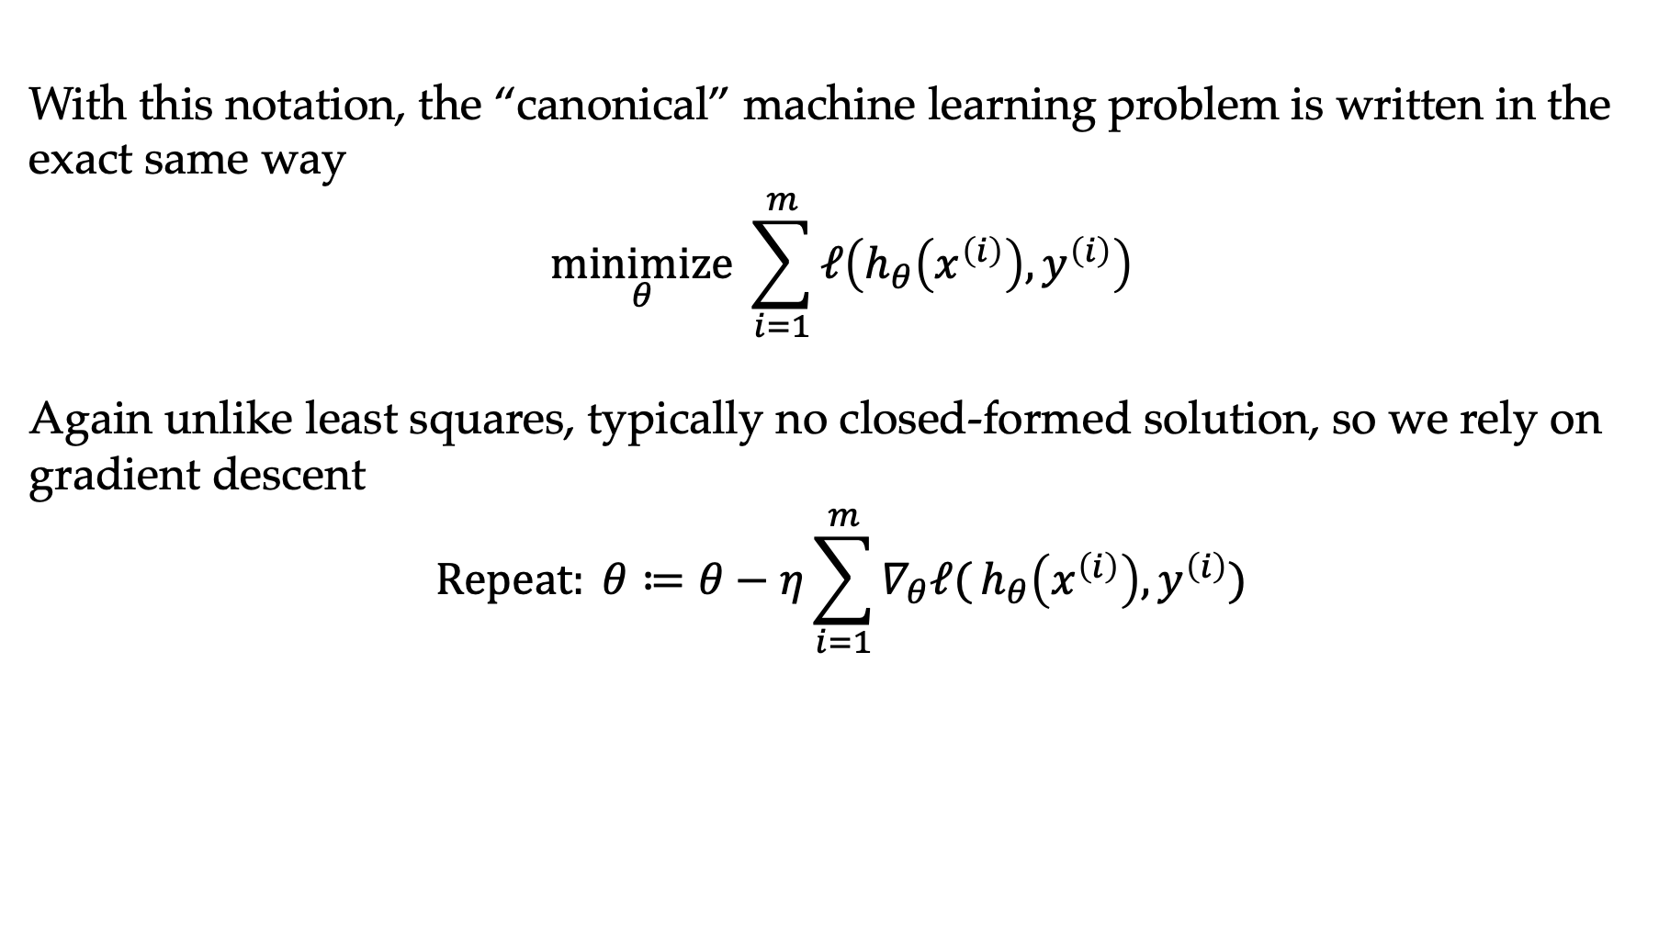
Machine learning optimization
With this notation, the “canonical” machine learning problem is written in the exact same way
$$\underset{θ}{minimize}{\sum_{i=1}^{m}{ℓ\left(h_{θ}\left(x^{\left(i\right)}\right), y^{\left(i\right)}\right)}}$$
Again unlike least squares, typically no closed-formed solution, so we rely on gradient descent
$$Repeat: θ≔θ−η\sum_{i=1}^{m}{∇_{θ}ℓ(}h_{θ}\left(x^{\left(i\right)}\right), y^{\left(i\right)})$$

Slide 44
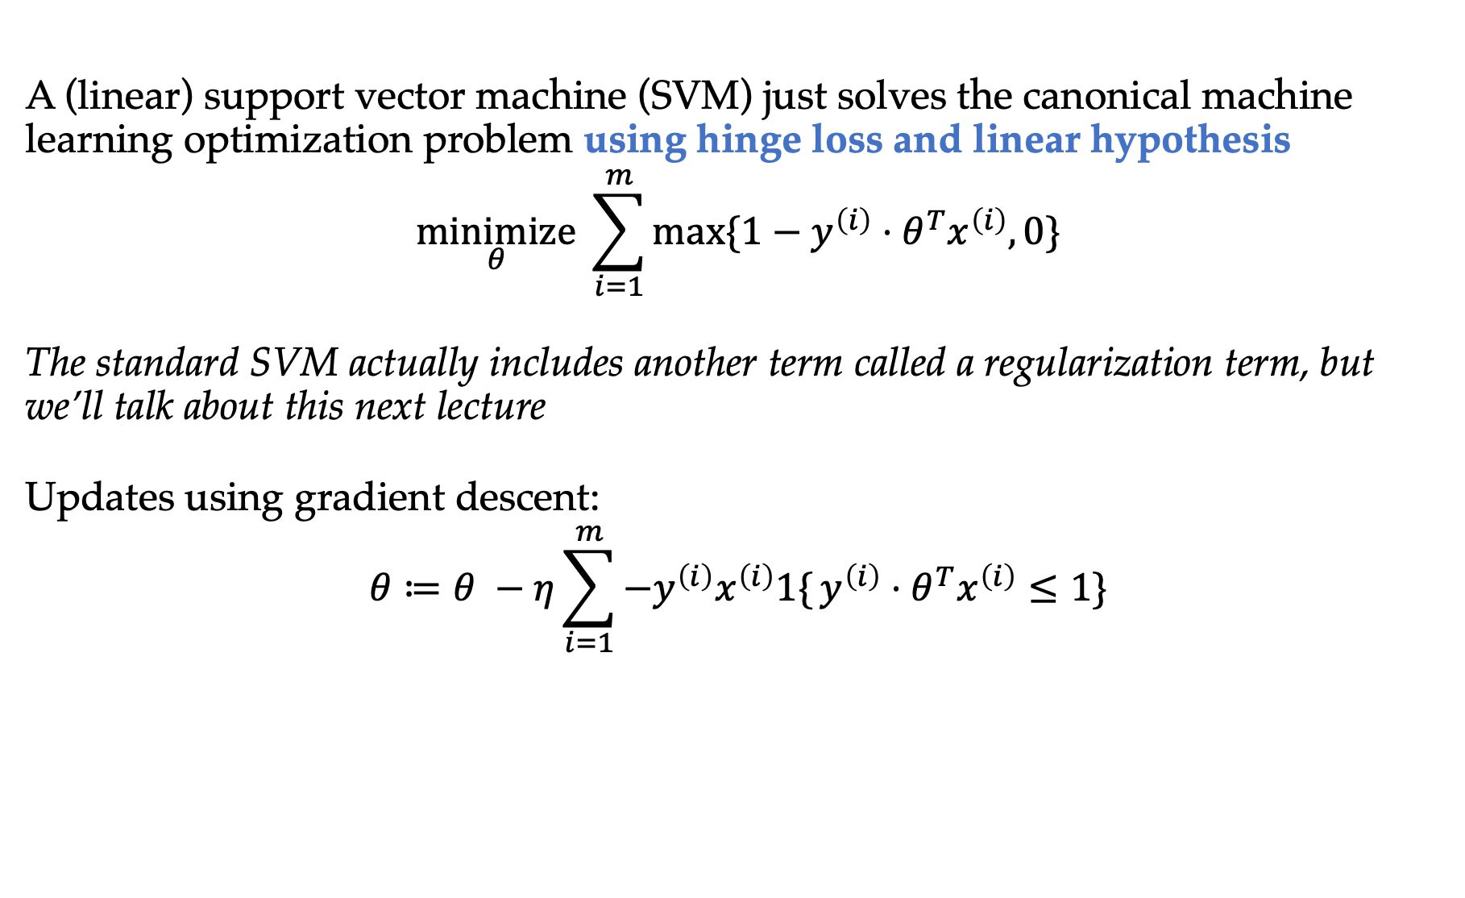
Support vector machine
A (linear) support vector machine (SVM) just solves the canonical machine learning optimization problem using hinge loss and linear hypothesis
$$\underset{θ}{minimize} \sum_{i=1}^{m}{max⁡\{1−y^{\left(i\right)}⋅θ^{T}x^{\left(i\right)},0\}}$$
The standard SVM actually includes another term called a regularization term, but we’ll talk about this next lecture
Updates using gradient descent:
$$θ≔θ −η\sum_{i=1}^{m}{{−y}^{\left(i\right)}x^{\left(i\right)}1\{}y^{\left(i\right)}⋅θ^{T}x^{\left(i\right)}≤1\}$$
Linear penalty if wrong and no penalty if confidently correct

Slide 45
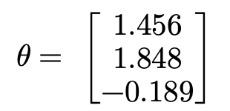
Support vector machine example
Running support vector machine on cancer dataset
$$θ= \left[\begin{matrix}1.456 \\ 1.848 \\ −0.189\end{matrix}\right]$$

Slide 46
SVM optimization progress
Optimization objective and error versus gradient descent iteration number
Hinge loss
0-1 error

Slide 47
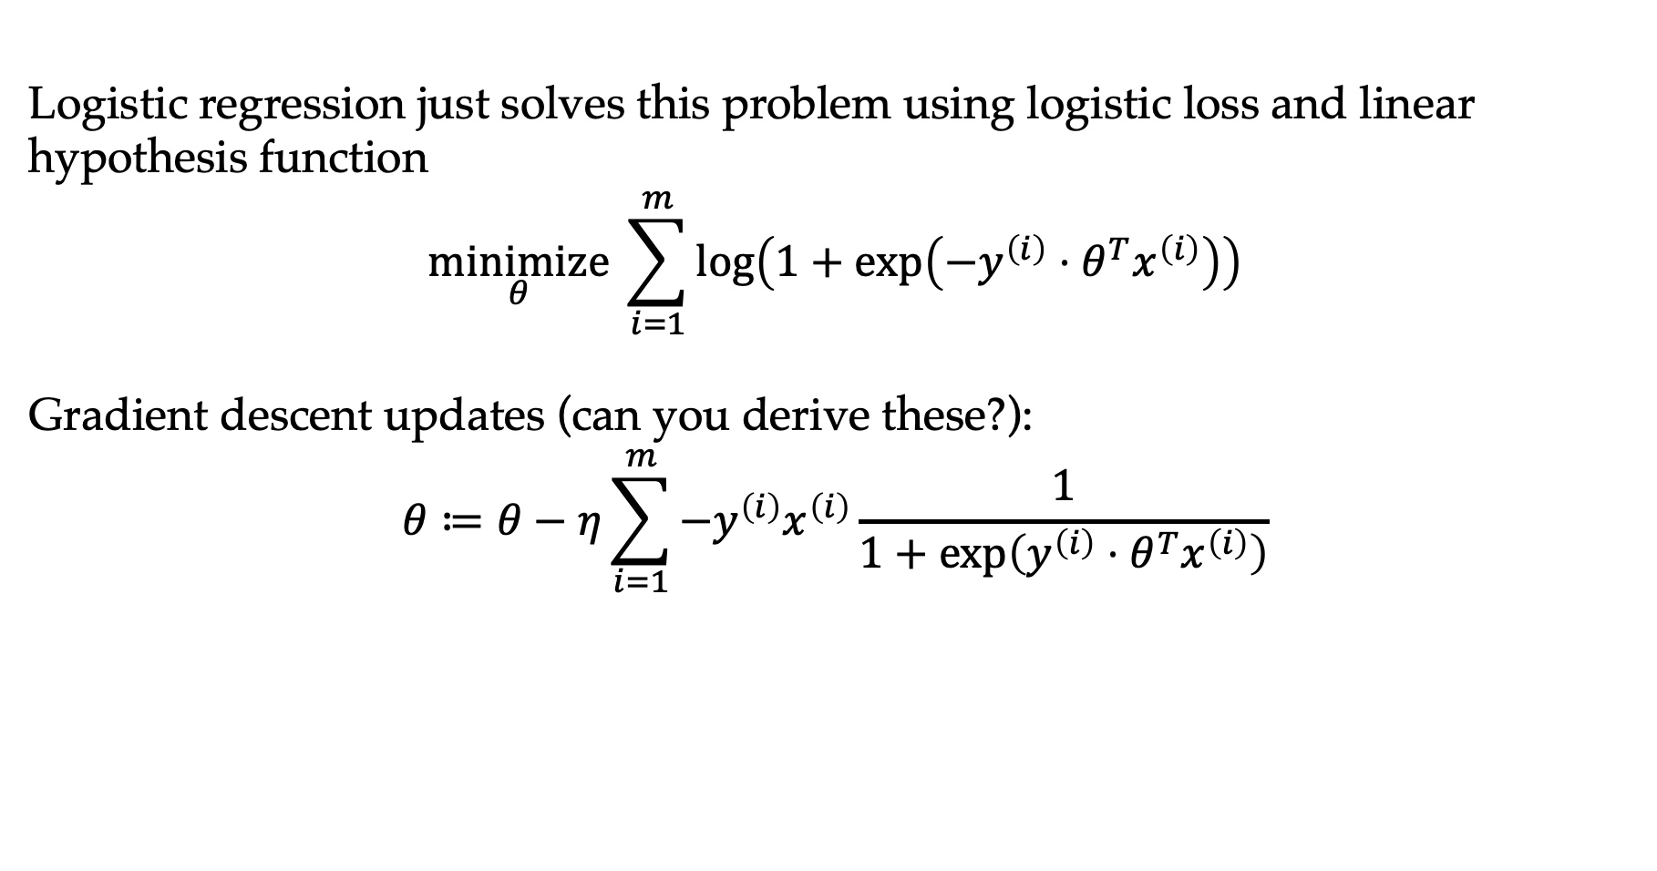
Logistic regression
Logistic regression just solves this problem using logistic loss and linear hypothesis function
$$\underset{θ}{minimize} \sum_{i=1}^{m}{\log\left(1+\exp\left({−y}^{\left(i\right)}⋅θ^{T}x^{\left(i\right)}\right)\right)}$$
Gradient descent updates (can you derive these?):
$$θ≔θ−η\sum_{i=1}^{m}{−y^{\left(i\right)}x^{\left(i\right)}}\frac{1}{1+\exp\left(y^{\left(i\right)}⋅θ^{T}x^{\left(i\right)}\right)}$$

Slide 48
Logistic regression example
Running logistic regression on cancer data set

Slide 49
Logistic regression example
Running logistic regression on cancer data set

Slide 50
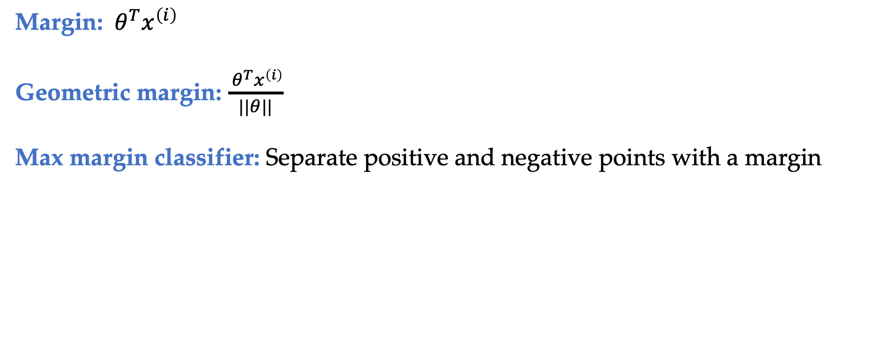
Margin view of SVMs
Margin: ${ θ}^{T}x^{\left(i\right)}$
Geometric margin: $\frac{{ θ}^{T}x^{\left(i\right)}}{||θ||}$
Max margin classifier: Separate positive and negative points with a margin
https://cs229.stanford.edu/notes2022fall/main_notes.pdf

Slide 51
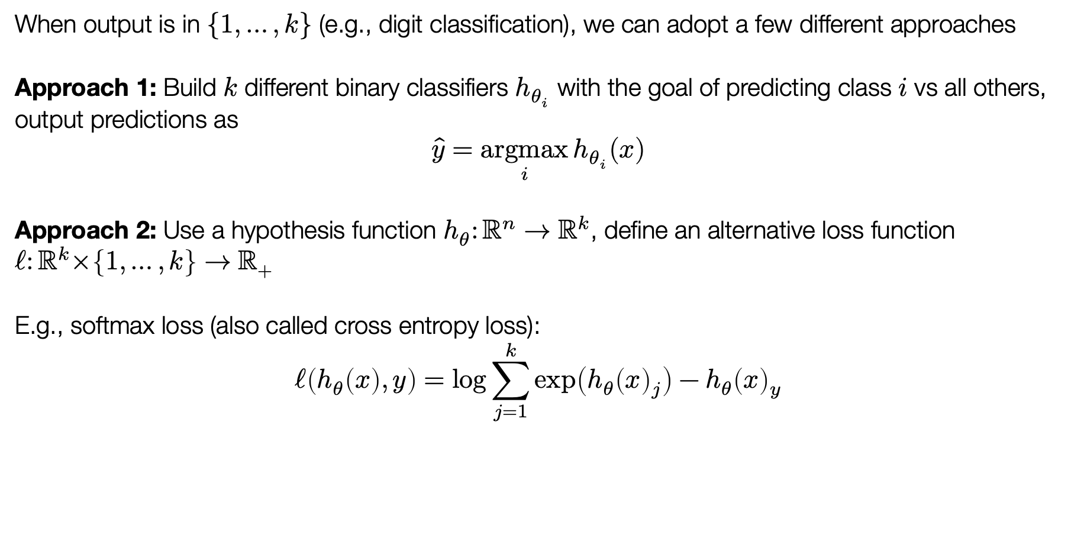
Multiclass classification
When output is in $\{1,…,k\}$ (e.g., digit classification), we can adopt a few different approaches
Approach 1: Build $k$ different binary classifiers $h_{θ_{i}}$ with the goal of predicting class $i$ vs all others, output predictions as
$$\hat{y}=\underset{i}{argmax}{h_{θ_{i}}(x)}$$
Approach 2: Use a hypothesis function $h_{θ}:ℝ^{n}→ℝ^{k}$, define an alternative loss function $ℓ:ℝ^{k}×\left\{1,…,k\right\}→ℝ_{+}$
E.g., softmax loss (also called cross entropy loss):
$$ℓ\left(h_{θ}\left(x\right),y\right)=\log{\sum_{j=1}^{k}{\exp\left(h_{θ}{\left(x\right)}_{j}\right)}−h_{θ}{\left(x\right)}_{y}}$$

Slide 52
Outline
What is machine learning?
Linear regression
Linear classification
Nonlinear methods

Slide 53
Peak demand vs. temperature (summer months)

Slide 54
Peak demand vs. temperature (all months)

Slide 55
Linear regression fit

Slide 56
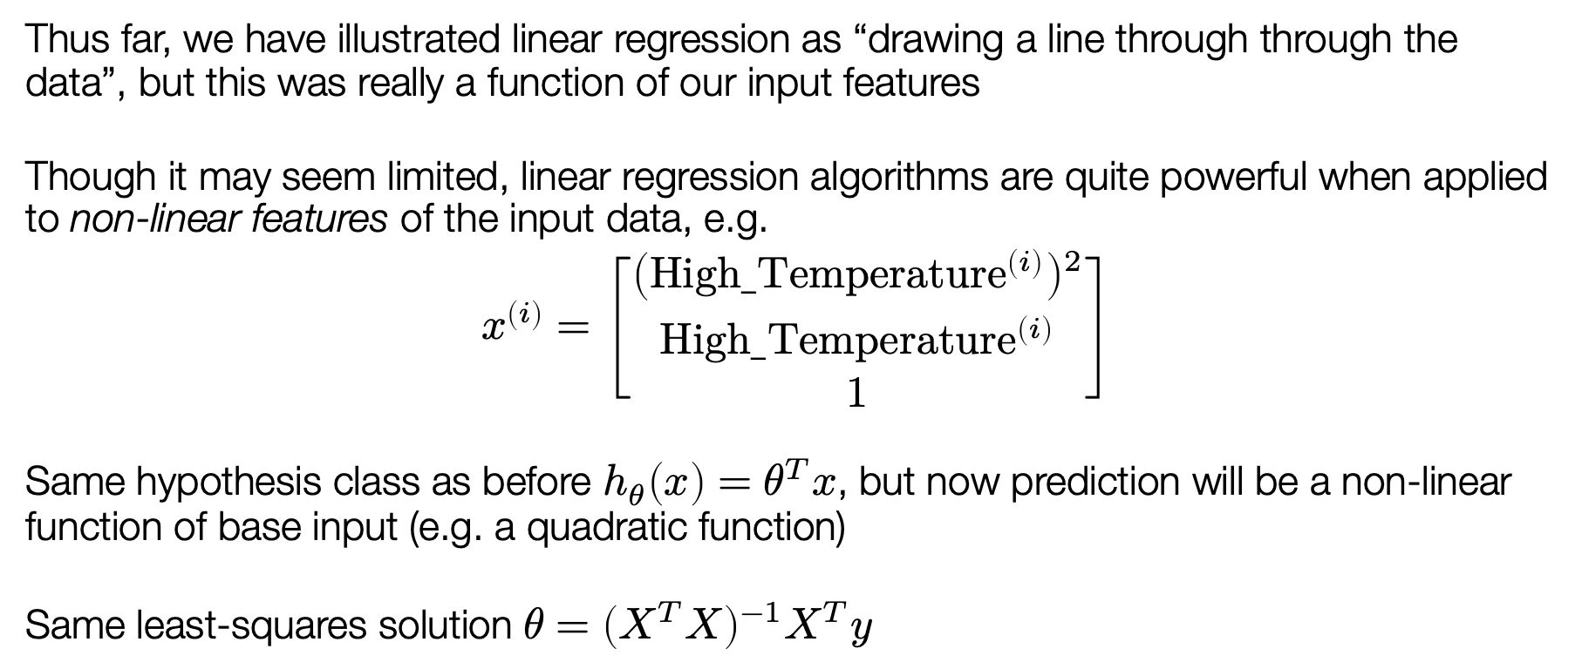
“Non-linear” regression
Thus far, we have illustrated linear regression as “drawing a line through through the data”, but this was really a function of our input features
Though it may seem limited, linear regression algorithms are quite powerful when applied to non-linear features of the input data, e.g.
$$x^{\left(i\right)}=\left[\begin{matrix}{\left(High_{Temperature}^{\left(i\right)}\right)}^{2} \\ High_{Temperature}^{\left(i\right)} \\ 1\end{matrix}\right]$$
Same hypothesis class as before $h_{θ}\left(x\right)=θ^{T}x$, but now prediction will be a non-linear function of base input (e.g. a quadratic function)
Same least-squares solution $θ={\left(X^{T}X\right)}^{−1}X^{T}y$

Slide 57
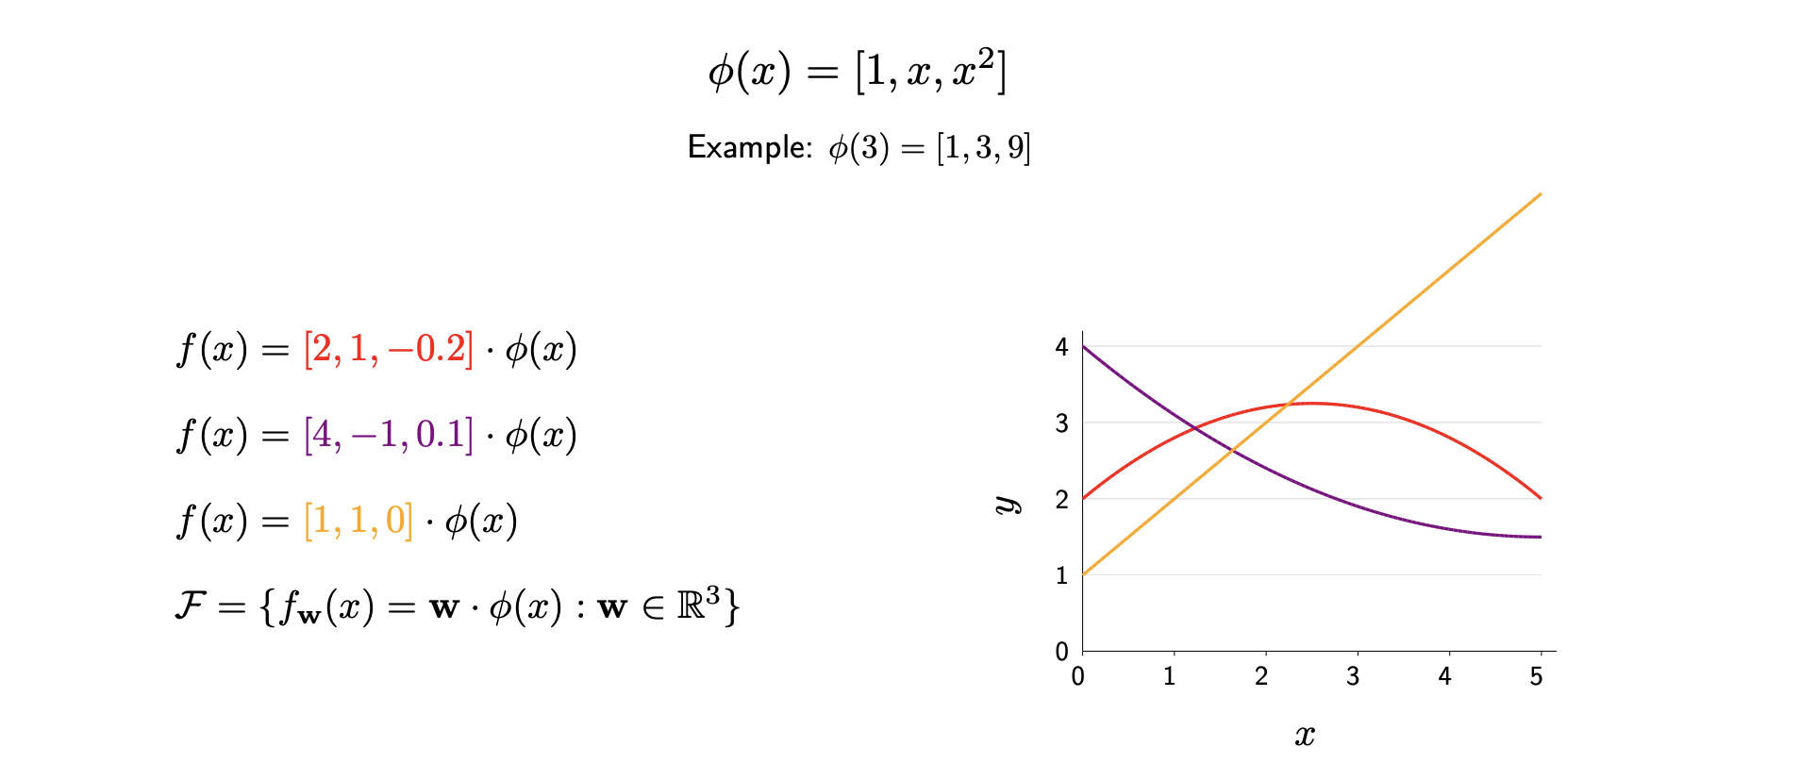
Non-linear predictors from linear machinery
Slide credit: CS221 Stanford

Slide 58
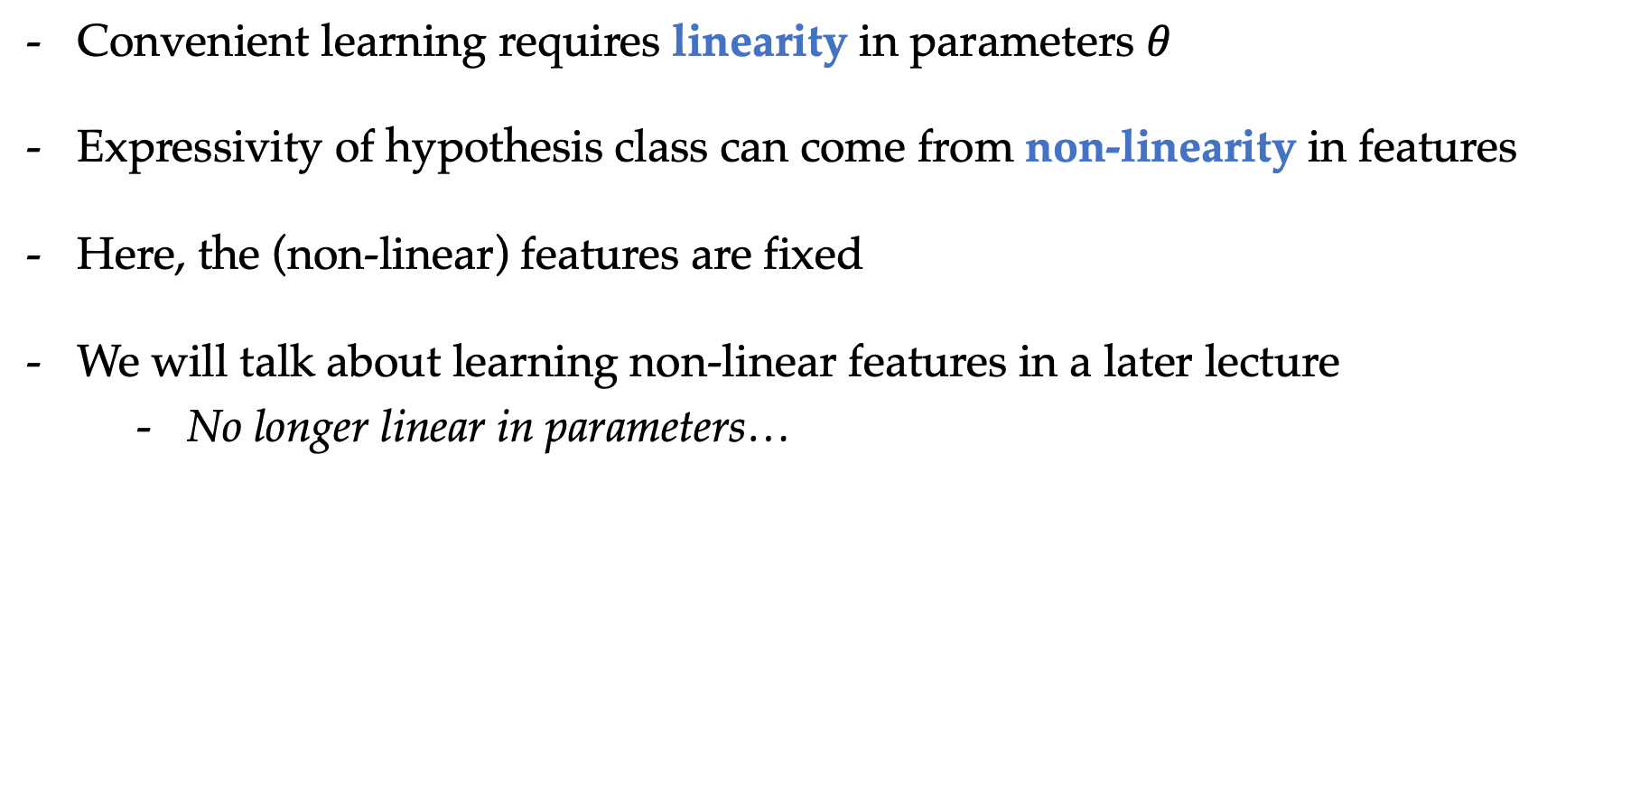
Non-linear predictors from linear machinery
Convenient learning requires linearity in parameters $θ$
Expressivity of hypothesis class can come from non-linearity in features
Here, the (non-linear) features are fixed
We will talk about learning non-linear features in a later lecture
  No longer linear in parameters…

Slide 59
Polynomial features of degree 3

Slide 60
Polynomial features of degree 4

Slide 61
Polynomial features of degree 10

Slide 62
Polynomial features of degree 50

Slide 63
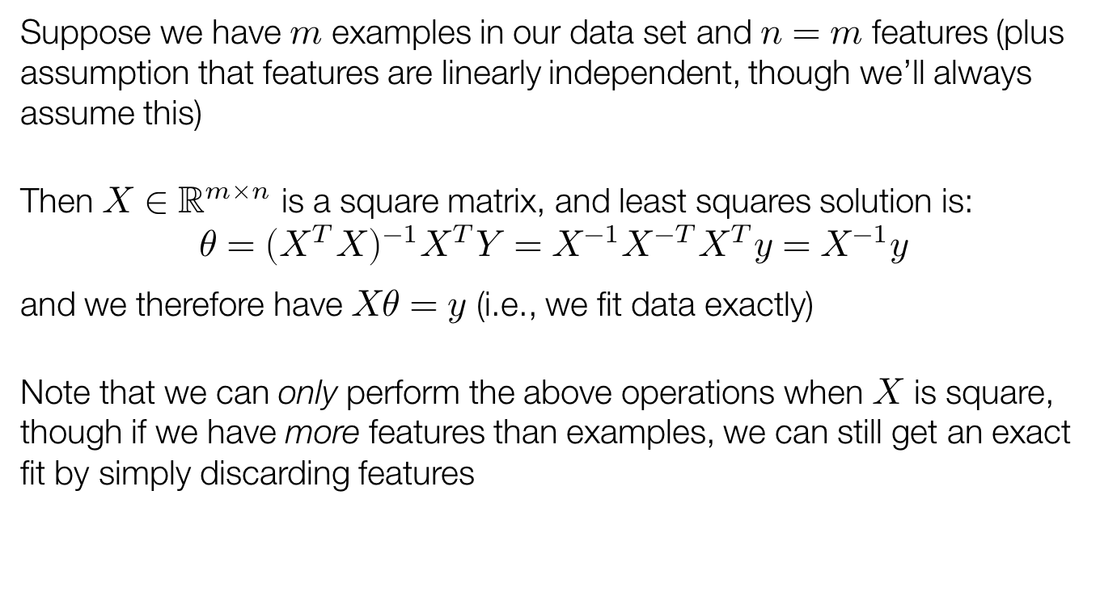
Linear regression with many features
Suppose we have $m$ examples in our data set and $n=m$ features (plus assumption that features are linearly independent, though we’ll always assume this)
Then $X∈ℝ^{m×n}$ is a square matrix, and least squares solution is:
$$θ={\left(X^{T}X\right)}^{−1}X^{T}Y=X^{−1}X^{−T}X^{T}y=X^{−1}y$$
and we therefore have $Xθ=y$ (i.e., we fit data exactly)
Note that we can only perform the above operations when $X$ is square, though if we have more features than examples, we can still get an exact fit by simply discarding features

Slide 64
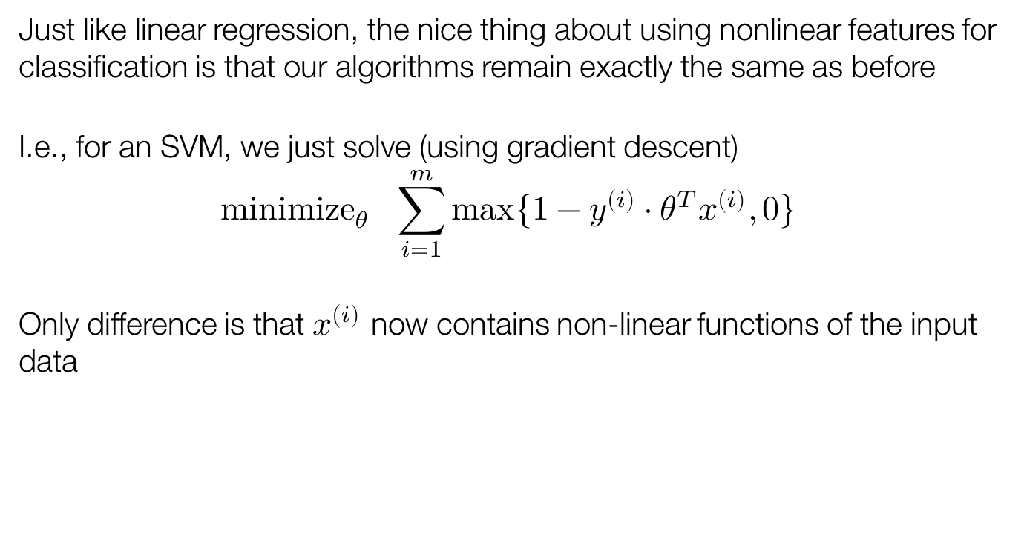
Nonlinear classification
Just like linear regression, the nice thing about using nonlinear features for classification is that our algorithms remain exactly the same as before
I.e., for an SVM, we just solve (using gradient descent)
$${minimize}_{θ} \sum_{i=1}^{m}{max⁡\{1−y^{\left(i\right)}⋅θ^{T}x^{\left(i\right)},0\}}$$
Only difference is that $x^{\left(i\right)}$ now contains non-linear functions of the input data

Slide 65
Linear SVM on cancer data set

Slide 66

Polynomial features $d=2$

Slide 67

Polynomial features $d=3$

Slide 68
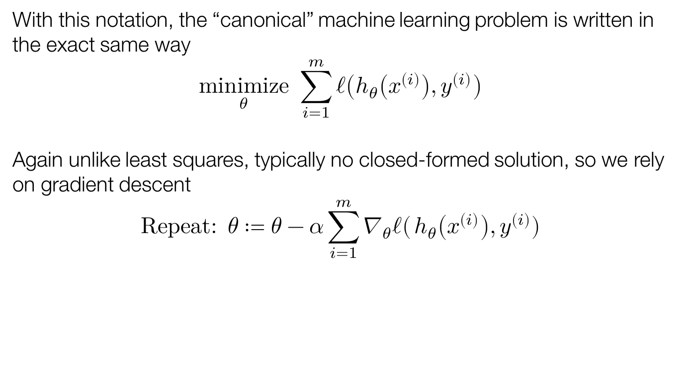
Polynomial features $d=10$

Slide 69
Coming up next
Train loss -> test loss (generalization, overfitting etc.)
Neural networks
Unsupervised learning
How to get to ChatGPT?

